Slide 1

University of Central Florida CGS 2545 Database Concepts

Slide 2
Manage Users
MySQL defines users with a username and the hostname or IP address that they're using to access the MySQL instance
To create a new user in MySQL, specify the username, the hostname the user can use to access the database management system, and a secure password

Slide 3
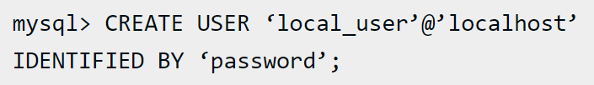
Manage Users
The command will allow the user with username local_user to access the MySQL instance from the local machine (localhost) and prevent the user from accessing it directly from any other machine.

Slide 4
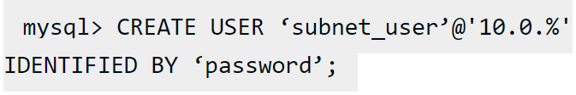
Manage Users
Alternatively, use a wildcard character (%) in the host definition to grant access to the MySQL instance for a user
In the example, the `10.0.%` specifies that the user can access the MySQL instance from any client that has an IP address beginning with `10.0.`.
May use the wild card at any level of the IP address in the host definition

Slide 5

Manage Users
To view all users in your MySQL instance, use the SELECT command
MySQL user account management
Without privileges, a newly created user account can connect to the MySQL instance but cannot access any data or perform any actions

Slide 6
Manage Users
Understanding privileges in MySQL
In MySQL, a privilege is a right to perform an action on a database that must be granted to users.
This effectively defines a user's access level on a database and what they can do within it.
Can organize these privileges by scope into levels
Information about MySQL privileges are stored in grant tables in the `mysql` database within the MySQL instance

Slide 7
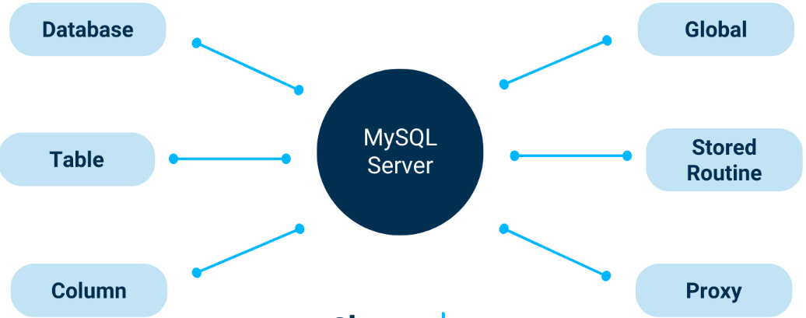
Manage Users
Understanding privileges in MySQL

Slide 8
Manage Users
Understanding privileges in MySQL
Global privileges
apply to all databases on the server
Administrative privileges fall into the global group because they enable a user to manage operations of the MySQL server and aren't specific to a particular database.
Database privileges
Apply to specific databases in your MySQL instance and all of the objects within those databases (e.g. tables, columns, and views)
Can also grant database privileges globally

Slide 9
Manage Users
Understanding privileges in MySQL
Proxy privileges
Allow a user to act as if they have the privileges granted to another user.
Privileges for database objects (tables, columns, stored routines, views, etc.)
Can apply to all objects of one type within a particular database or to specific objects, such as a certain table or view
Can also grant database object privileges globally

Slide 10
Manage Users
Understanding privileges in MySQL
Some common privileges include:
`ALL PRIVILEGES`: The user is granted all privileges except GRANT OPTION and PROXY.
`ALTER`: The user can change the structure of a table or database.
`CREATE`: The user can create new databases and tables.
`DELETE`: The user can delete rows in a table.
`INSERT`: The user can add rows to a table.
`SELECT`: The user can read rows from a table.
`UPDATE`: The user can update rows in a table.

Slide 11
Manage Users
Understanding privileges in MySQL
Some common privileges include:
`ALL PRIVILEGES`: The user is granted all privileges except GRANT OPTION and PROXY.
`ALTER`: The user can change the structure of a table or database.
`CREATE`: The user can create new databases and tables.
`DELETE`: The user can delete rows in a table.
`INSERT`: The user can add rows to a table.
`SELECT`: The user can read rows from a table.
`UPDATE`: The user can update rows in a table.

Slide 12
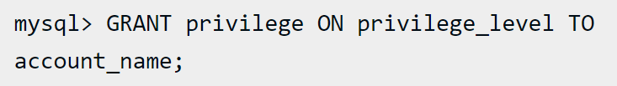
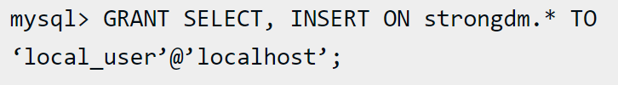
Manage Users
Grant permissions to a MySQL user account
The GRANT statement allows you to set MySQL access permissions using the following syntax
Type the following to grant `SELECT` and `INSERT` privileges to a local user

Slide 13

Manage Users
Grant permissions to a MySQL user account
To create a user with the same privileges as the root user, use the following command, which grants global privileges to the user connecting via localhost
The WITH GRANT OPTION clause allows users to grant their privileges to other users

Slide 14

Manage Users
Revoke permissions from a MySQL user account
To remove privileges, use the REVOKE command, which uses a syntax similar to the GRANT command.
To revoke `SELECT` and `INSERT` privileges from a local user on the database
If the user does not actually have the privileges, the command will not affect any of the privileges

Slide 15

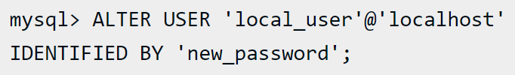
Manage Users
Change a MySQL user account password
The syntax to change a user password depends on the version of MySQL
To find out the MySQL version you are running, use the command
To change a password for MySQL 5.76 or higher, use this command

Slide 16
Manage Users
Delete MySQL users
To delete a MySQL user, use the DROP command
Display MySQL user account privileges
To view the privileges of a MySQL user, use the `SHOW GRANTS` command

Slide 17
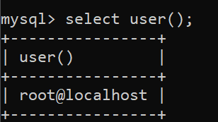

Manage Users
Show user
To show the currently logged in user, use the command
Change user
To change the logged in user, use the command and enter the password when prompted

